Slide 1
Model-free in Visual Tracking
Xiao Ma

Slide 2
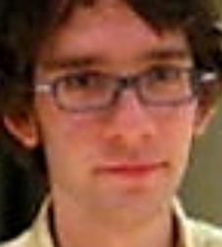
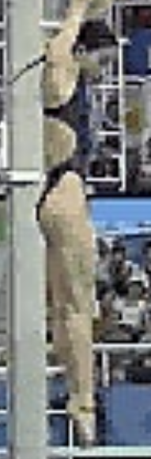
This is OK..
Grid-like structure, typically a bounding box, is employed to represent the target object for tracking. Since most of the tracked target is not strictly a rectangular shape, the bounding box representation often inevitably incorporates background information into the model, and thus could degrade the overall performance of the tracker. Therefore, the grid-like structure is not the optimal way to represent real objects that are of non-rectangular shape.
But this....
Object
Background information

Slide 3
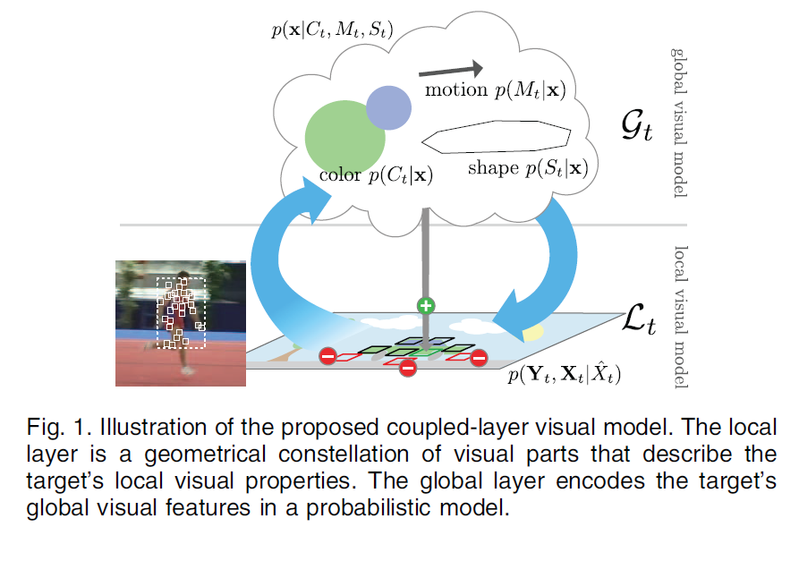
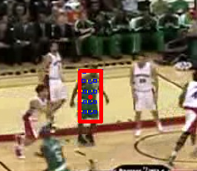
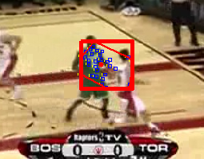
Two Classic Model-free Methods: LGT
Uniformly generate a set of local patches;
Using Kalman filters to track those patches;
Patches’ positions will form a convex polygon, the final tracking results are determined by this polygon’s borders.

Slide 4
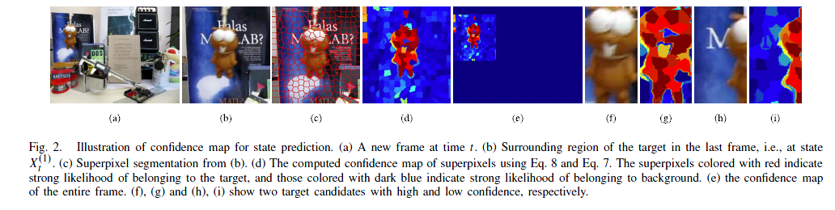
Two Classic Model-free Methods: SPT
Using mean shift to cluster the similar pixels with certain spatial postitions for the objects and backgrounds, call this middle-level discriminative appearance based tracking are super-pixel tracking.

Slide 5
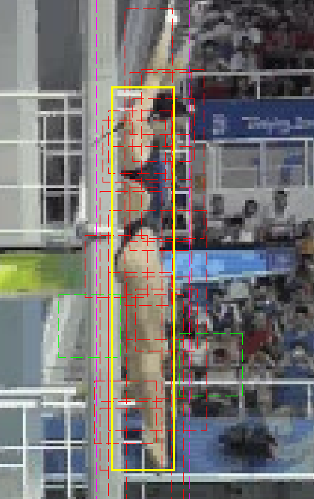
Model-free in CVPR 2015
Li Y, Zhu J, Hoi S C H. Reliable Patch Trackers: Robust Visual Tracking by Exploiting Reliable Patches[C]//Proceedings of the IEEE Conference on Computer Vision and Pattern Recognition. 2015: 353-361.
Generate a set of local patches according Guassian distribution;
Using KCF to track those patches;
Using a a Hough voting-like scheme to synthesize the tracking results of each patches.
Local patches

Slide 6
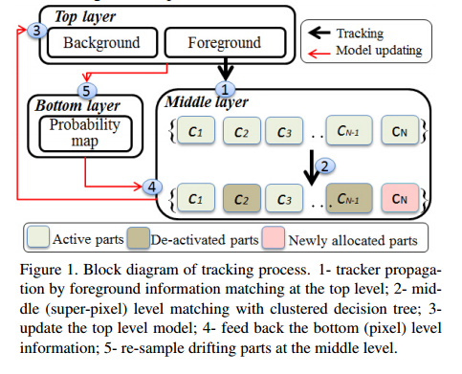
Model-free in CVPR 2015
Xiao J, Stolkin R, Leonardis A. Single target tracking using adaptive clustered decision trees and dynamic multi-level appearance models[C]//Proceedings of the IEEE Conference on Computer Vision and Pattern Recognition. 2015: 4978-4987.
Using 3 layers ：colors( probaility map); superpixels; bounding boxes;
Using a novel cluster decsion tree manage superixels.
This paper.

Slide 7
Overall procedure
Model-free in CVPR 2015:DAT
Possegger H, Mauthner T, Bischof H. In Defense of Color-based Model-free Tracking[C]//Proceedings of the IEEE Conference on Computer Vision and Pattern Recognition. 2015: 2113-2120.
Object model update
Object model update
Object model update
Localization
Localization
Localization
Scale estimation
Scale estimation
Scale estimation
Tracking result
Tracking result
Tracking result

Slide 8
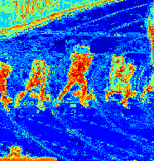
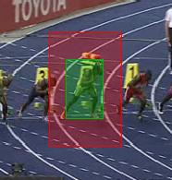
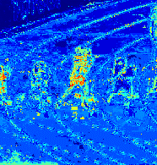
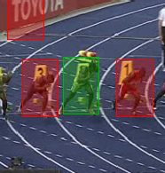
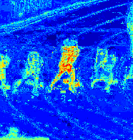
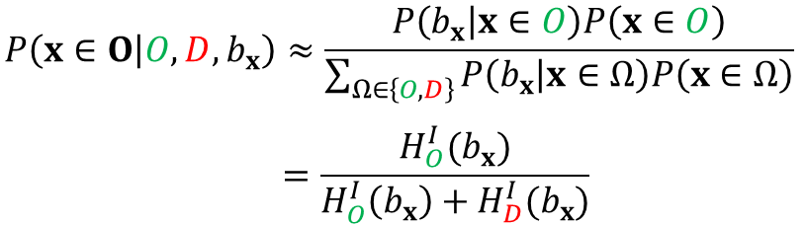
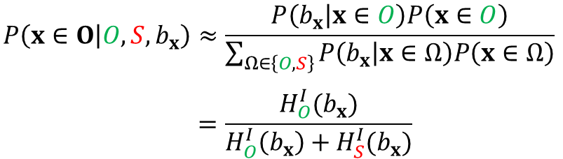
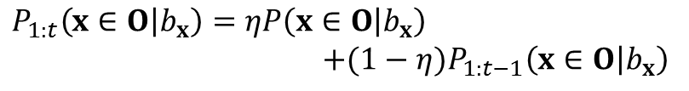
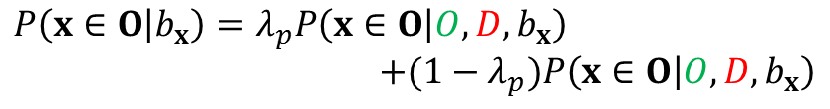
Distractor-aware object model
Model-free in CVPR 2015:DAT
Object-surrounding model
$$P\left(x∈O | O,S,b_{x}\right)≈\frac{P\left(b_{x} | x∈O\right)P\left(x∈O\right)}{\sum_{Ω∈\left\{O,S\right\}}{P\left(b_{x} | x∈Ω\right)P\left(x∈Ω\right)}}$$
$$=\frac{H_{O}^{I}(b_{x})}{H_{O}^{I}\left(b_{x}\right)+H_{S}^{I}(b_{x})}$$
Distractor-aware model
$$P\left(x∈O | O,D,b_{x}\right)≈\frac{P\left(b_{x} | x∈O\right)P\left(x∈O\right)}{\sum_{Ω∈\left\{O,D\right\}}{P\left(b_{x} | x∈Ω\right)P\left(x∈Ω\right)}}$$
$$=\frac{H_{O}^{I}(b_{x})}{H_{O}^{I}\left(b_{x}\right)+H_{D}^{I}(b_{x})}$$
Combined model
$$P\left(x∈O | b_{x}\right)=λ_{p}P\left(x∈O | O,D,b_{x}\right) \\ +(1−λ_{p})P\left(x∈O | O,D,b_{x}\right)$$
$$P_{1:t}\left(x∈O | b_{x}\right)=ηP\left(x∈O | b_{x}\right)$$
$$+(1−η)P_{1:t−1}\left(x∈O | b_{x}\right)$$

Slide 9


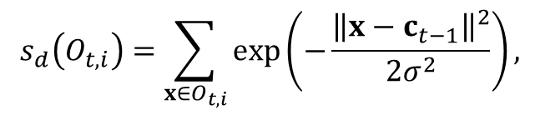
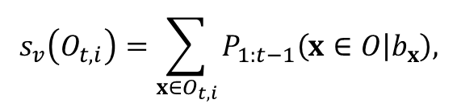
Localization
Model-free in CVPR 2015:DAT
Localization
$$O_{t}^{∗}=\arg{\max\left(s_{v}\left(O_{t,i}\right)∙s_{d}\left(O_{t,i}\right)\right),}$$
$$s_{v}\left(O_{t,i}\right)=\sum_{x∈O_{t,i}}{P_{1:t−1}\left(x∈O | b_{x}\right),}$$
$$s_{d}\left(O_{t,i}\right)=\sum_{x∈O_{t,i}}{\exp\left(−\frac{{\left\|x−c_{t−1}\right\|}^{2}}{2σ^{2}}\right),}$$
$O_{t,i}$ be a distractor if $s_{v}\left(O_{t,i}\right)≥λ_{v}s_{v}\left(O_{t}^{∗}\right)$

Slide 10
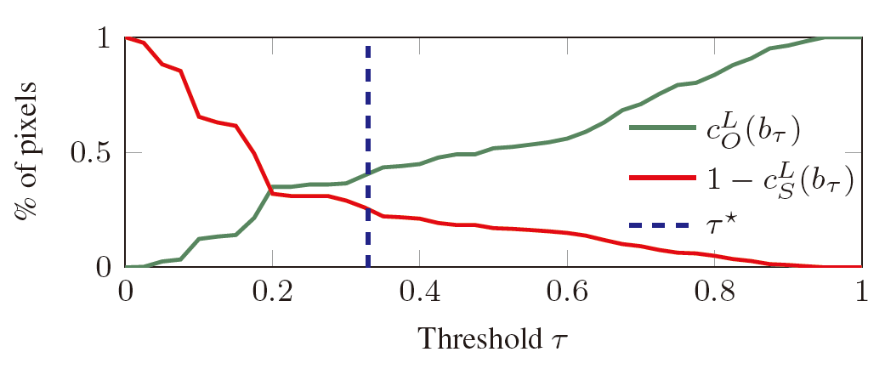
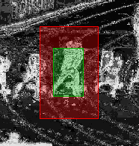
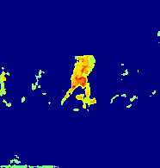
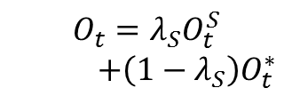

Scale estimation
Model-free in CVPR 2015:DAT
Find adaptive threshold $τ^{∗}$
$$τ^{∗}=\arg{\min\left(\left(c_{O}^{L}\left(b_{τ}\right)+c_{S}^{L}\left(b_{τ}\right)\right)−\left(c_{O}^{L}\left(b_{τ}+1\right)−c_{O}^{L}\left(b_{τ}\right)\right)\right),}$$
$$s.t. c_{O}^{L}\left(b_{τ}\right)+c_{S}^{L}\left(b_{τ}\right)≥1.$$
Thresholding
BB Update
Model update
$$O_{t}=λ_{S}O_{t}^{S}$$
$+\left(1−λ_{S}\right)O_{t}^{∗}$

